Slide 1
Multiplexers
A multiplexer is a circuit that passes one of its multiple inputs to a single output based on a select input.
This can be thought of as a digital switch.
The multiplexer has n select lines, 2^{n} inputs, and one output

Slide 2
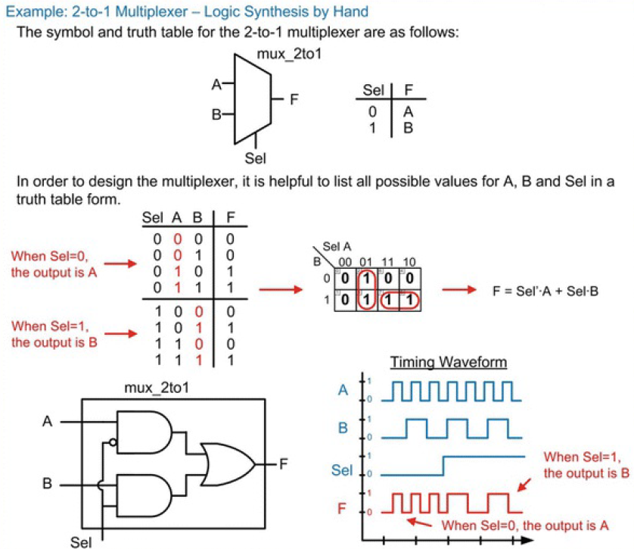

Slide 3
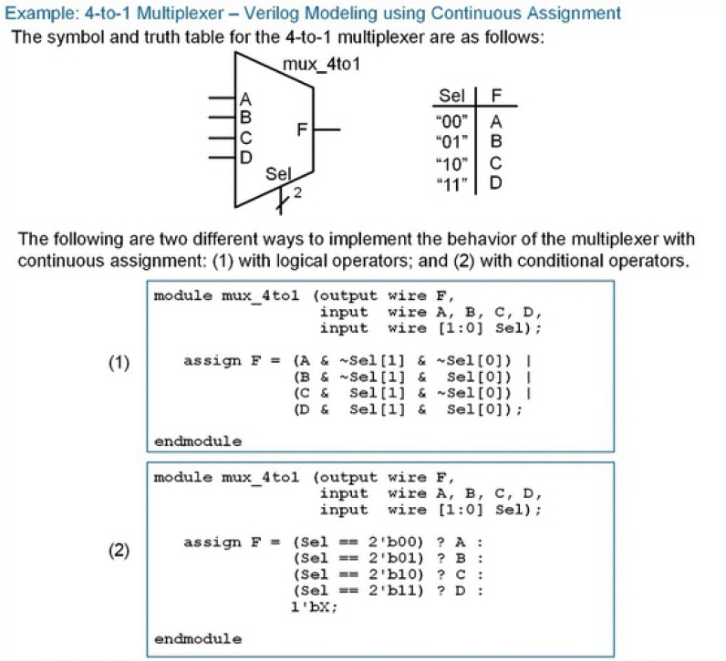

Slide 4
Demultiplexers
A demultiplexer works in a complementary fashion to a multiplexer. A demultiplexer has one input that is routed to one of its multiple outputs.
The output that is active is dictated by a select input.
A demux has n select lines that chooses to route the input to one of its 2^{n} outputs.
When an output is not selected, it outputs a logic 0.

Slide 5
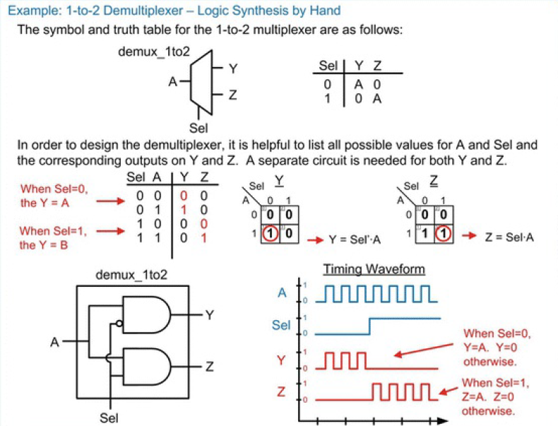
0 | 0
0 | 1

Slide 6
